Slide 1
Example
https://youtu.be/XDF02KmgJFE?t=1h6m26s
Right automatization
By Max Dorofeev
Notes:
1

Slide 2



… two months before.
Dev: “Some workers spend around 40 hours per month to make reports MANUALLY.
Let’s automate it to save their time!”
Notes:
2

Slide 3

Extra simple business process example.
We have organization of two humans …
Notes:
3

Slide 4

… and they dig potatoes …
Notes:
4

Slide 5

Notes:
5

Slide 6
It is necessary to pass report!
Notes:
6

Slide 7

It is necessary to pass report!
Notes:
7

Slide 8

It is necessary to pass report!
Notes:
8

Slide 9

It is necessary to pass report!
Notes:
9

Slide 10

It is necessary to pass report!
Notes:
10

Slide 11
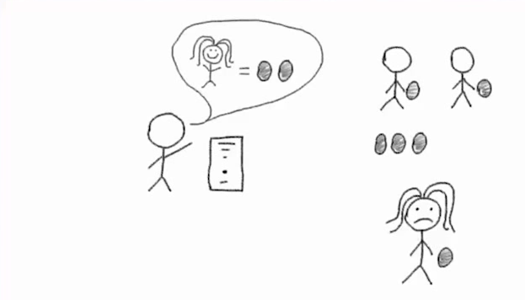
It is necessary to pass report!
Notes:
11

Slide 12

It is necessary to pass report!
Notes:
12

Slide 13
Every 4th fails!!! (* CHAOS report)
It is necessary to pass report!
* https://www.projectsmart.co.uk/white-papers/chaos-report.pdf
Notes:
13

Slide 14
Every 4th fails!!! (* CHAOS report)
It is necessary to pass report!
* https://www.projectsmart.co.uk/white-papers/chaos-report.pdf
Notes:
14

Slide 15
It is necessary to pass report!
Notes:
15

Slide 16

It is necessary to pass report!
Notes:
16

Slide 17
It is necessary to pass report!
Notes:
17

Slide 18
It is necessary to pass report!
Notes:
18

Slide 19

It is necessary to pass report!
Notes:
19

Slide 20

It is necessary to pass report!
Notes:
20

Slide 21
It is necessary to pass report!
Benefit!
Notes:
21

